Slide 1
Invest your Capital with Confidence
© Ausus Partners 2015

Slide 2
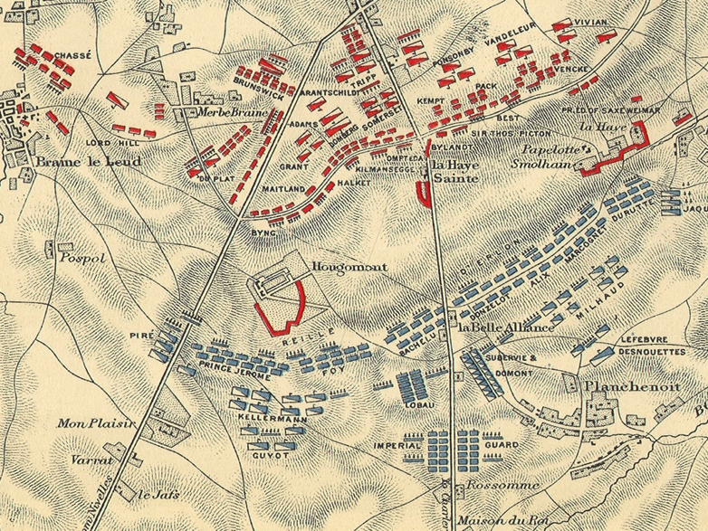
There’s Optionality When You Have a Margin of Safety.
“Have a margin of safety with your investments. Allow for the possibility that you might be wrong, that something unexpected may happen.”
–Dr. Ken Shuben Stein, Founder & Portfolio Manager, Spencer Capital Management
“Buy to the sound of cannons, sell to the sound of trumpets.”
--Attributed to Baron Rothschild
What should your margin of safety be?
We provide the answers.
Image: Battle Map of Waterloo
© Ausus Partners 2015

Slide 3
The right Behaviors are a Business Advantage.
Warren Buffet looks for 4 types of Advantages an investor can have in an investment
Informational: when you have better info
Analytical: when you have more insights
Behavioral: when your decision-making is more objective
Structural: when an investment’s value has nothing to do with its worth
“How can I overcome my behavioral biases and be more objective? By having analytical and informational insights that helps me behave more rationally.”
–Dr. Benjamin Graham, Columbia Business School, the Father of Value Investing
© Ausus Partners 2015

Slide 4
Objective & Reasoned Financial Insights.
Ausus Partners specializes in providing in-depth financial analysis for Captive Insurance Company formation. We provide proven methods for analyzing your future Captive:
I
Cost Benefit advice allowing our clients to understand the Opportunity Cost of their alternative risk financing strategy
Our proprietary Stress Tests adversely model your new captive’s potential failure points
II
© Ausus Partners 2015

Slide 5
Objective & Reasoned Financial Insights.
1
2
Our Cost Benefit analysis works for the 2 defining scenarios:
For potential investments where expenses, underwriting costs and premiums are fairly well known
For potential investments where expenses, total premiums (including those ceded) or other expenses are not well known prior to formation
© Ausus Partners 2015

Slide 6
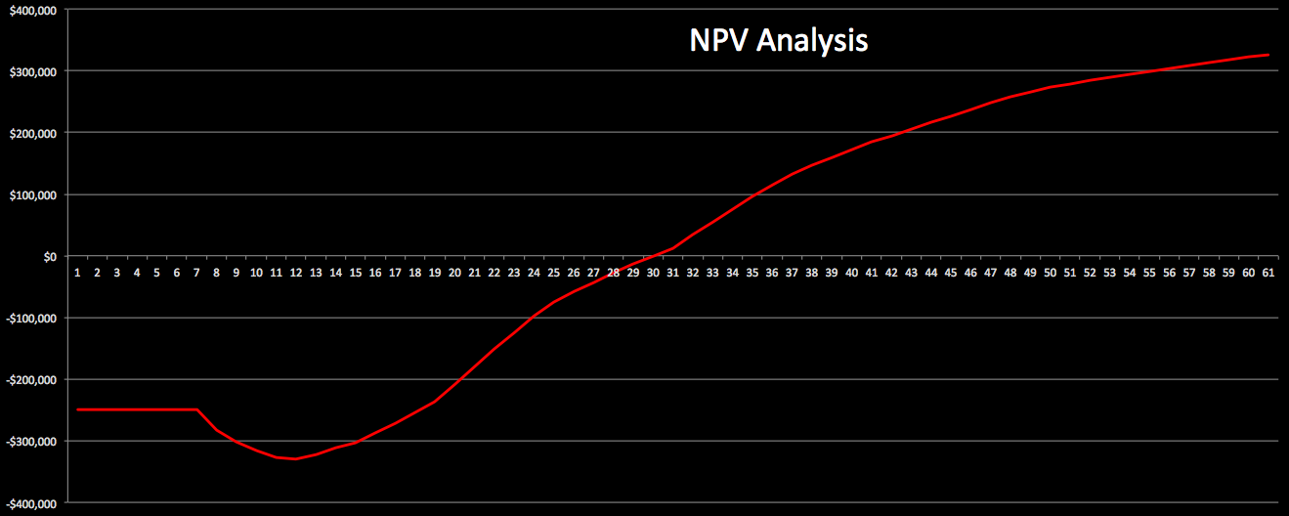
Cost Benefit Analysis 1: DCF and NPV Analysis.
Net Present Value (NPV) modeling using Discounted Cash Flows (DCF) is a proven method to compare a new investment to one where with known returns.
An NPV model will let a parent company compare a new investment to its historic rate of return. And because a future CIC will someday pay dividends, there’s little argument it should be treated as an investment.
© Ausus Partners 2015

Slide 7
Cost Benefit Analysis 1: DCF and NPV Analysis.
Our testing is built for new Captive Insurance Companies and measures key pro forma ratios and NAIC IRIS Ratios.
It is specifically designed to help investors understand the Opportunity Cost of a potential investment.
Our NPV models will let a parent company compare a new investment to its historic rate of return.
Perfect for a Single Parent where a known risk is being shifted to a captive.
Can also value a captive before and after bringing MGA/MGU services in-house
© Ausus Partners 2015
Notes:
e.g. Net Underwriting Income to NEP, Total Losses to NEP, NWP:Surplus, Non-Loss Expenses: NWP,
IRIS = Insurance Regulatory Information System and are NAIC’s collection of solvency tools to analyze insurance companies.

Slide 8
Cost Benefit Analysis 2: Discovery Driven Growth Modeling.
But there are times when there is a lot of uncertainty and much is assumed in a new Captive.
In these cases the model is lacking specific data in the projections, e.g. revenues are based on probable policy sales to as yet unknown individuals.
Top Down DCF modeling may not make sense in this situation. With multiple unknowns, a Bottom Up analysis is suggested to remove as much uncertainty as possible.
Such uncertainty calls for The Wharton Business School’s Discovery Driven Growth Model, and requires Reverse Engineering the pro forma financials.
“Discovery-driven planning recognizes that planning for a new venture involves envisioning the unknown.” The Harvard Business Review, August 1995
© Ausus Partners 2015
Notes:
https://hbr.org/1995/07/discovery-driven-planning/ar/1
discovery-driven planning systematically converts assumptions into knowledge as a strategic venture unfolds.

Slide 9
Cost Benefit Analysis 2: Discovery Driven Growth Modeling.
Together The Wharton Business School and the Columbia Business School created a process for evaluating new subsidiary companies (NewCo).
By working backwards from a company’s needed profitability, through fixed and variable costs, to a NewCo’s needed revenues; modeling small investments and scaling up.
 | Reverse Income Statement
 | Initial Modeling
 |  |  |  |  | Benchmark Source
 | Current Corporate Profits |  | 10,000,000 |  | Annual Report
 | Current Return on Sales |  | 5% |  | Annual Report
 | Current Return on Assets |  | 12% |  | Annual Report
 | NewCo Profitability Goal |  | 8% |  | Corporate Policy
 | NewCo ROS Goal |  | 7.5% |  | Corporate Policy
 | NewCo ROA Goal |  | 15% |  | Corporate Policy
 | NewCo Required Profits |  | 800,000 |  | Calculation | (Current Profits * Profitability Goal)
 | NewCo Required Revenues |  | 10,666,667 |  | Calculation | (Required Profits/ROS Goal)
 | NewCo Allowable Assets |  | 5,333,333 |  | Calculation | (Required Profits/ROA Goal)
 | NewCo Allowable Costs |  | 9,866,667 |  | Calculation | (Required Revenues - Required Profits)
© Ausus Partners 2015

Slide 10
Cost Benefit Analysis 2: Discovery Driven Growth Modeling.
Similarly, Ausus Partners can value a potential captive. Even with many unknowns a CIC can be adequately evaluated over almost any future time period prior to formation.
By working backwards from the regulatory requirements of surplus and capital through fixed and underwriting costs to needed premium, Ausus Partners can build a ground up look at a new captive.
In this analysis, being right isn’t the goal. The goal is learning the tools to be disciplined and investing small amounts once milestones are hit; only investing when you learn.
A parent company can learn to spot when it’s making unconscious assumptions.
© Ausus Partners 2015

Slide 11
Discipline matters.
Follow the Discovery Driven Growth process:
Learn Cheap
&
Learn Fast
© Ausus Partners 2015

Slide 12
Stress Testing with Failure Mode Effects Analysis (FMEA).
A future captive that has been endorsed by your actuary and that will comply with your regulator’s requirements can be stressed in ways similar to how NASA tests spacecraft design.
With Failure Mode Effects Analysis (FMEA)
© Ausus Partners 2015

Slide 13
Stress Testing with Failure Mode Effects Analysis (FMEA).
An analysis technique that facilitates the identification of potential problems by examining the effects of lower level failures.
FMEA determines the effect of each failure and identifies points that are critical. It may also rank each failure according to the criticality of a failure effect and its probability of occurring.
© Ausus Partners 2015

Slide 14
Stress Testing with Failure Mode Effects Analysis (FMEA).
Simply put, the objective of a FMEA is to identify the way failures could occur and outline their consequences.
© Ausus Partners 2015
Notes:
Control unit is a parachute control unit.

Slide 15
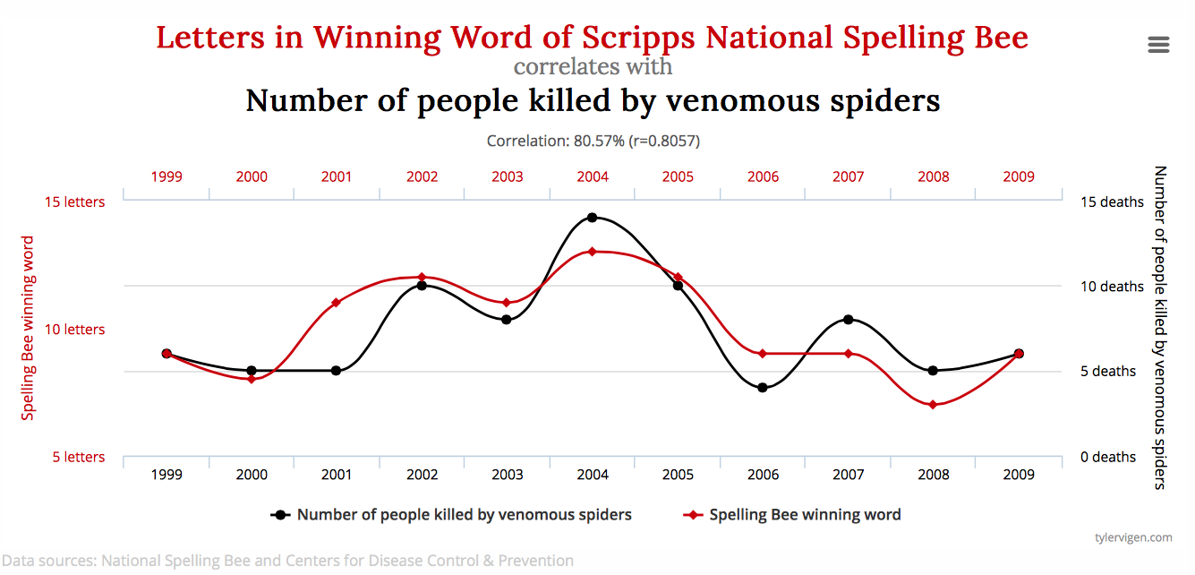
Stress Testing with Failure Mode Effects Analysis (FMEA).
An important part of FMEA is that big failures are based on small failures, so there are no spurious correlations.
© Ausus Partners 2015

Slide 16
FMEA and Captive Insurance.
By adversely modeling the inputs for sales activities, surplus, risk retention, underwriting expense and loss oversight, we can provide enhanced performance indicators for your captive.
How does this affect potential dividends or risk retention?
How does this affect the Parent’s cash on hand or earned premium?
Bottom Up Approach
Sales Missing Plan, Expenses Marginally higher, etc.
© Ausus Partners 2015

Slide 17
Discipline matters.
Ausus Partners specializes in providing in-depth financial analysis for Captive Insurance Company formation. Our analyses are specific to Captive formation.
As a former CFO, developed the pro forma financials for over 25 early-stage companies.
Founding Director and Audit Committee member of a Vermont-domiciled RRG, Terrafirma.
© Ausus Partners 2015

Slide 18
Invest your Capital with Confidence
www.AususPartners.net
1.888.364.0551
© Ausus Partners 2015

